Slide 1

Big Questions about Big Data
Luke Lonergan
Co-founder & CTO
Greenplum, A Division of EMC

Slide 2

1.
What’s the
big deal with
big data?

Slide 3
Big Data opens the door
to a new approach to
engaging customers and
making decisions.

Slide 4
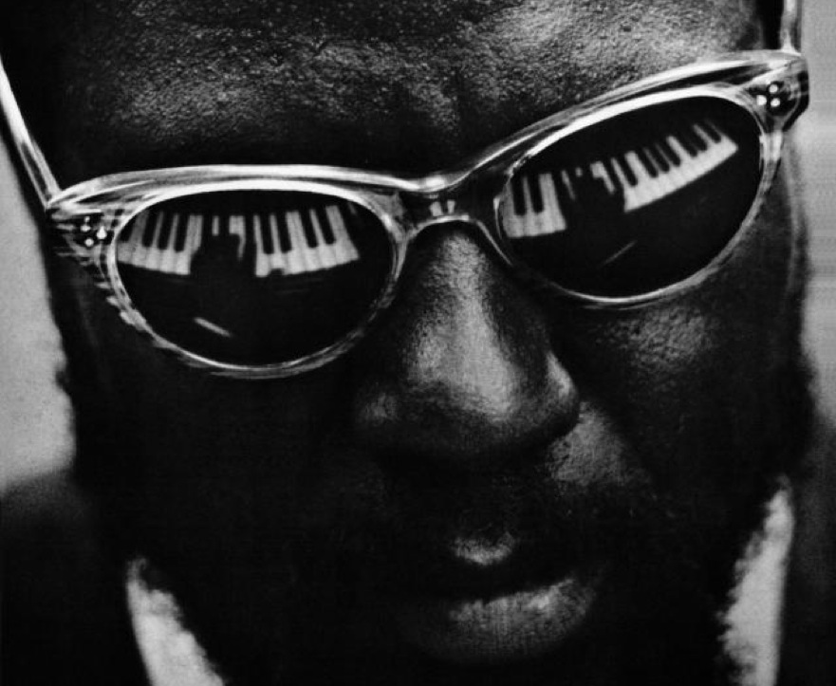
2.
Big Data:
Classical or Jazz?

Slide 5
Organizations will become
more like jazz bands
and less like orchestras.

Slide 6

Jeremy Lin
3.
Is there 10x more value with 10x
more data?

Slide 7
Yes, by using data that
businesses typically discard
or could not process due
to technology limitations.

Slide 8
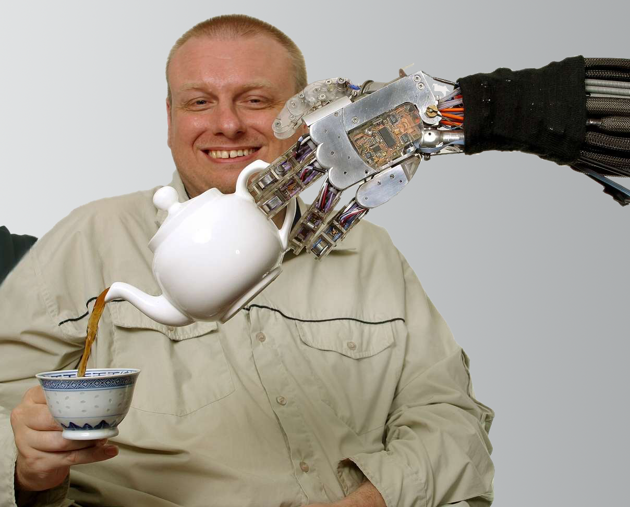
4.
What technologies support Big Data analytics?

Slide 9
Scale-out everything:
Storage
Compute
Analytics
Interaction

Slide 10

5.
Is BIG Data the Future?

Slide 11
The new normal
requires agile, predictive
big data capabilities.

